Slide 1


GRADE 8 ICT/DESIGN
Lesson 7: Identifying User Needs (Code.org)
Ms. Abboud • Grade 8 - ICT/Design • Term 1, Week 6

Slide 2
Learning Objectives
WALT - We Are Learning To
WILF - What I'm Looking For
Analyze interview notes to identify specific user needs.
Each need is backed by a quote or detail from the interview.
The app idea clearly addresses one identified need.

Slide 3
Academic Vocabulary
Interview
Barrier
Asking someone questions directly to learn about their needs, habits, or opinions.
Something that gets in the way of a user doing what they need to do.
Opportunity
A chance to solve a problem or make something better for a user.

Slide 4
Frayer Model: Barrier
DEFINITION
CHARACTERISTICS
Something that gets in the way of a user doing what they need to do.
Blocks a user; can be physical, digital, or informational.
BARRIER
EXAMPLES
NON-EXAMPLES
An app that requires an account just to look at a menu.
A feature that makes something easier.

Slide 5
National Identity Integration
UAE value of majlis-style listening: understanding what someone truly needs starts with genuinely hearing them out, not assuming. Today you listen to users through their interviews.

Slide 6
STARTER
Journal: Hidden Needs
How can you find out what someone really needs, if they don't tell you directly?
Hook • Engage & Ask
5 - 10 minutes

Slide 7
LESSON CORE
I Do: Reading an Interview
3 Reads: first for the story, then for needs, then for barriers and opportunities.
Highlight the words that show what the user needs.
Gradual Release of Responsibility
35 - 45 minutes
1 / 3

Slide 8
LESSON CORE
We Do: Barriers and Opportunities
In groups, share the barriers each user faces and the opportunities to help them.
Brainstorm app ideas for each user on poster paper.
Gradual Release of Responsibility
35 - 45 minutes
2 / 3

Slide 9
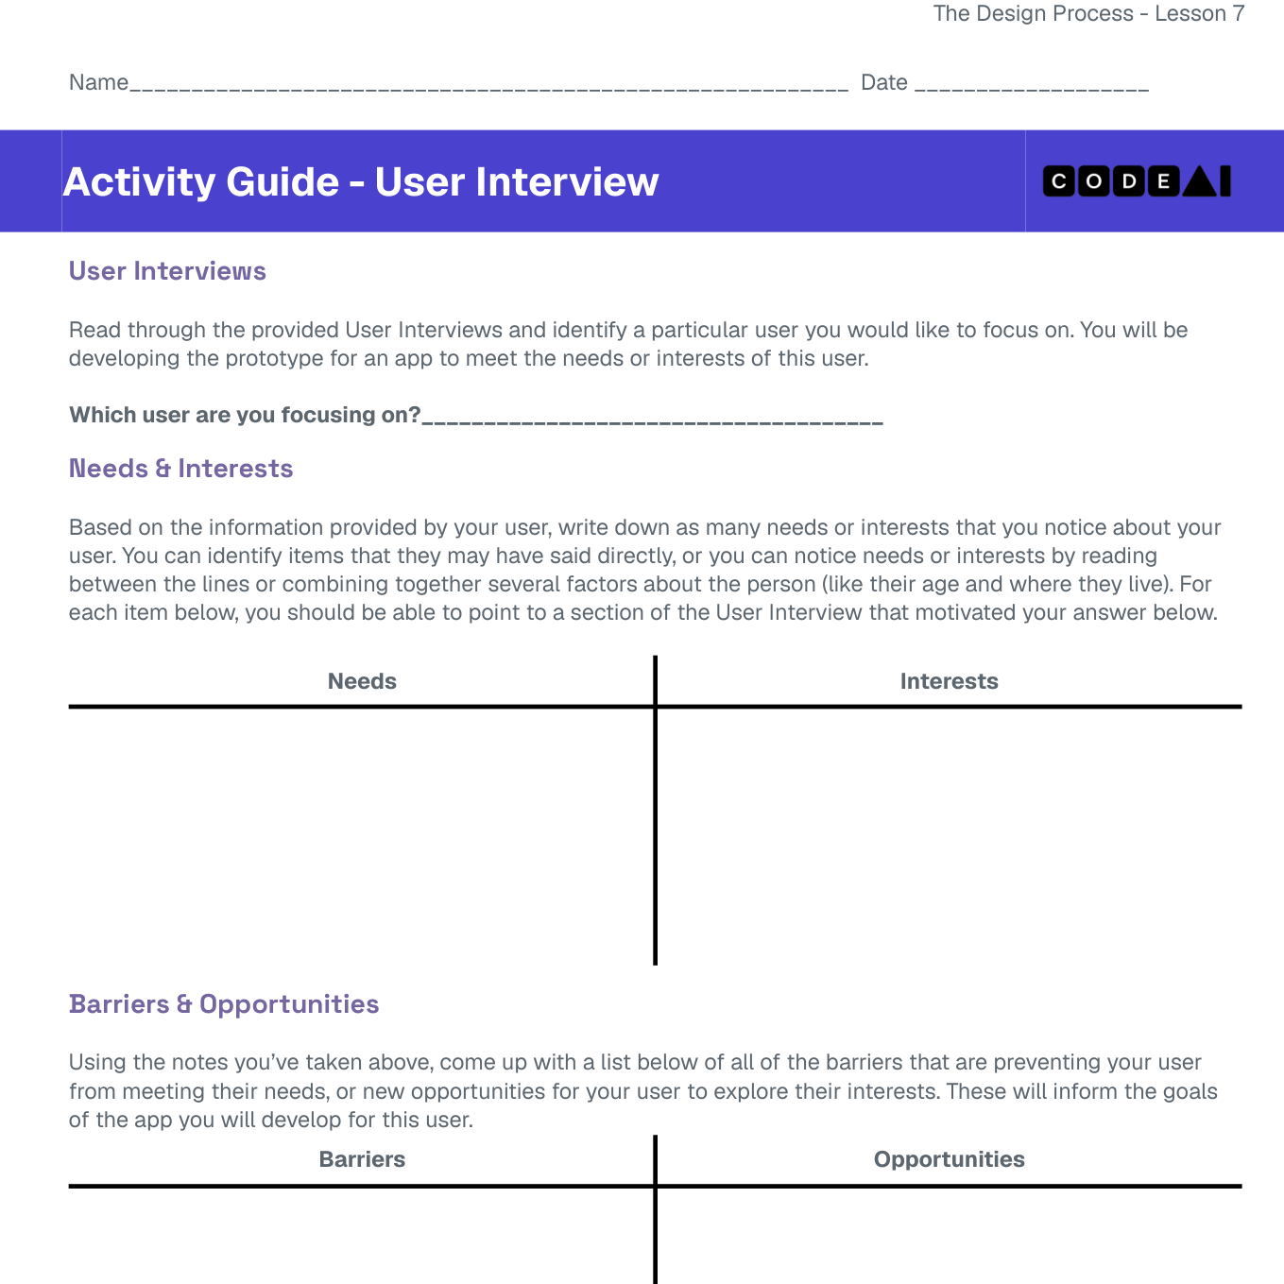
LESSON CORE
You Do: User Interviews
Choose one user and one app idea.
Write need statements backed by evidence from the interview.
Code.org activity: User Interviews
Gradual Release of Responsibility
35 - 45 minutes
3 / 3

Slide 10
CLOSURE
Formal Check
Formal Week 6 formative check: submit your improved screen and need statements via Toddle.
Transition & Extend
5 - 10 minutes

